Slide 1
3413ICT Network Security
Lecture 3A. Electronic Mail Security
Dr V. Muthukkumarasamy
B.Sc.Eng (Hons) (Peradeniya), PhD (Cantab), MIEE, MIEEE
Notes:
Griffith University, School of ICT
2010/1
3400ICT Information System Security
1
Griffith University, School of ICT
2010/1
3400ICT Information System Security
1

Slide 2
Previous Lecture..
Have studied:
Message Authentication Codes
Hash Functions
Digital signatures
Digital signature algorithm
Digital signature standard

Slide 3
Today’s Objectives
To learn the ways of providing Authentication & Confidentiality to email messages
To learn the operations of PGP & SMIME

Slide 4
References
Cryptography and Network Security: Principles and Practice, 6th ed.,
William Stallings: Chapter 19

Slide 5
Email Security
Email is one of the most widely used and regarded network services
Security threats to email services
Can be read and modified by unauthorized party, or by suitably privileged users on the destination system
Easily “spoofed” - they do not necessarily come from whom they claim to
Content/ origin forgery by recipient
Phishing
.........
Notes:
Current email services are roughly like "postcards". Anyone who wants could pick it up and have a look as its in transit or sitting in the recipients mailbox.

Slide 6
Email Security Goals
Confidentiality – protection from disclosure
Authentication – of sender of message
Message integrity – protection from modification
Non-repudiation of origin – protection from denial by sender
Notes:
What we want is something more akin to standard mail (contents protected inside an envelope) if not registered mail (have confidence about the sender of the mail and its contents).

Slide 7

Pretty Good Privacy (PGP)
Developed by Phil Zimmermann in 1991
It selected best available crypto algorithms to use
It’s integrated into a single program
It’s available to Windows, Unix, Macintosh, and many more
It was originally free, now it has commercial versions available also
Phil Zimmermann Jr.
(born February 1954)
is the creator of PGP
He is also known for
his work in VolP
encryption protocols.

Slide 8
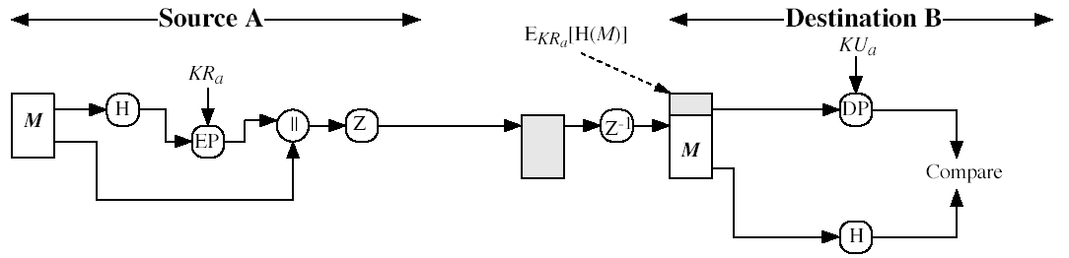
PGP Authentication
Sender creates a message
SHA-1 is used to generate 160-bit hash code of message
Hash code is encrypted (with RSA or DSS), using the sender's private key, and result is attached to message
Receiver uses sender's public key (with RSA or DSS) to decrypt and recover hash code
Receiver generates new hash code for message and compares with decrypted hash code, if match, message is accepted as authentic.

Slide 9
PGP Confidentiality
Sender generates message, as well as a session key Ks (which is random 128-bit number) to be used for this message only
Message is encrypted, using the session key Ks (with 3DES algorithm, for example)
Session key Ks is encrypted (using RSA algorithm, for example) with recipient's public key, then attached to message
Receiver uses its private key (with RSA algorithm) to decrypt and recover the session key
Session key then is used to decrypt message

Slide 10
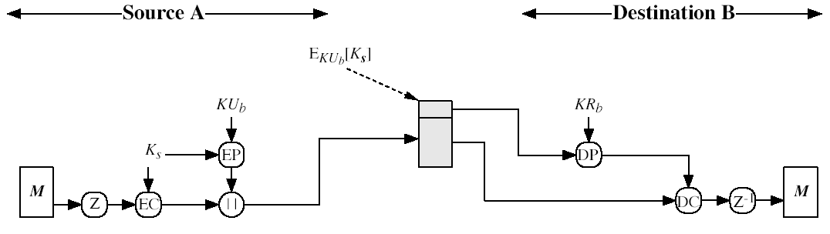
PGP Confidentiality
(Stallings Fig 18.1b)

Slide 11
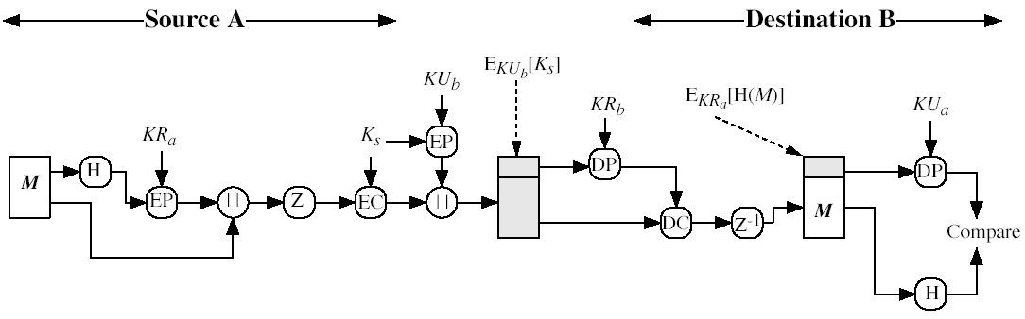
PGP Confidentiality & Authentication
PGP can provide both services on same message
Create signature, and attach it to message
Encrypt both message & signature
Attach encrypted (by RSA, for example) session key
(Stallings Fig 18.1c)

Slide 12
Data Compression & Conversion
PGP uses ZIP compression algorithm
By default, PGP compresses message after signing but before encrypting
The resulting data from PGP-signature and/or encryption will be in binary format
PGP converts data between text format (of email) and binary format by
using radix-64 algorithm

Slide 13
Radix-64 Encoding
6-bit value | Character Encoding
0 | A
1 | B
… | …
25 | Z
26 | a
… | …
51 | z
52 | 0
… | …
61 | 9
62 | +
63 | /
(pad) | =

Slide 14
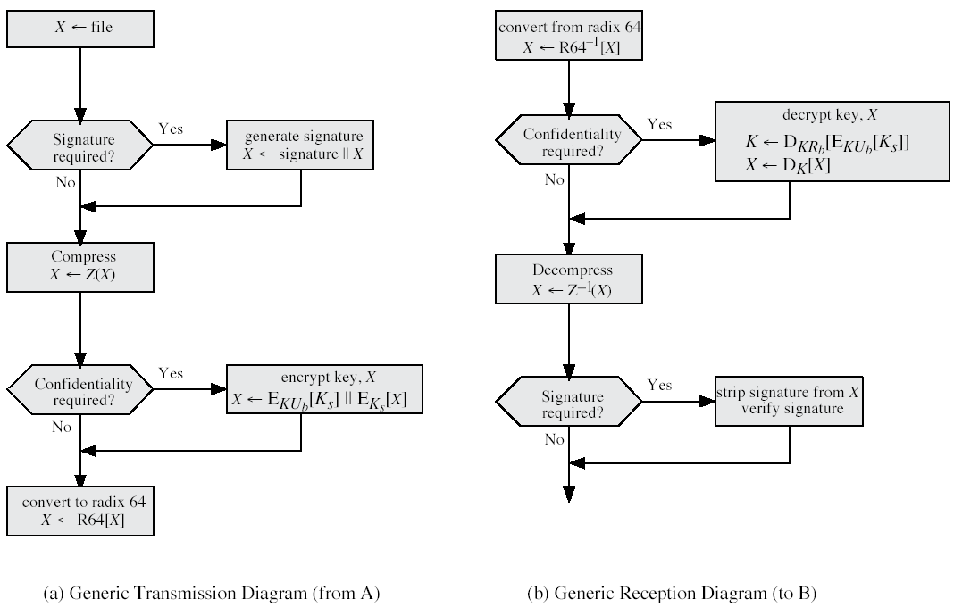
PGP Services Summary
(Stallings Fig 18.2)
Notes:
Stallings Fig 15-2.

Slide 15
PGP Session Keys
PGP needs a session key for each message:
It has variable sizes, for examples, 56-bit DES, 168-bit 3DES
Generated by a random number generator, from a random input
Random inputs are based on user’s keystroke inputs, combined with previous session key

Slide 16
PGP Public & Private Keys
PGP makes use of many one-time symmetric keys, and public/private keys
It allows each user to have multiple public-key and private-key pairs
How does the recipient know which of its public keys was used by the sender?
A simple solution is to transmit the full public key with the message – It is inefficient
Rather use a key identifier which
is least significant 64-bits of the key
will be unique within each user

Slide 17
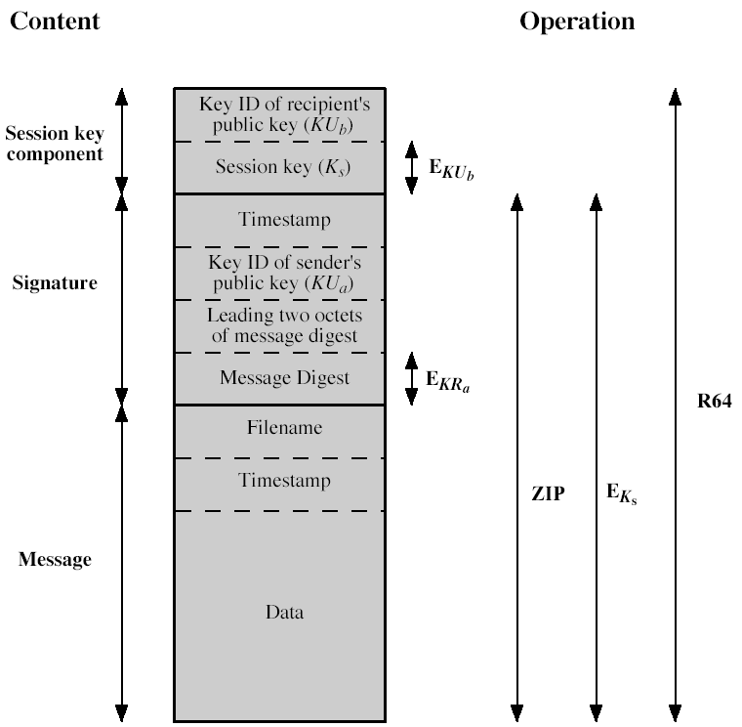
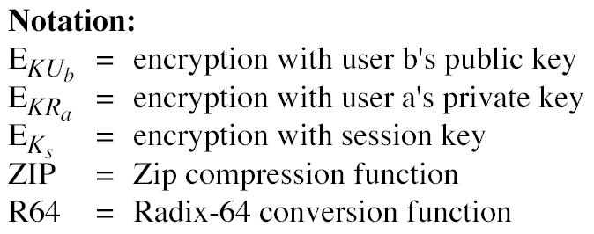
Format of PGP Message
(Stallings Fig 18.3)

Slide 18
PGP Key Rings
Each PGP user has a pair of key rings
Public-key ring contains all the public-keys of other PGP users known to this user, indexed by key IDs
Private-key ring contains the public/private key pairs for this user, indexed by key IDs, where the private keys are encrypted

Slide 19
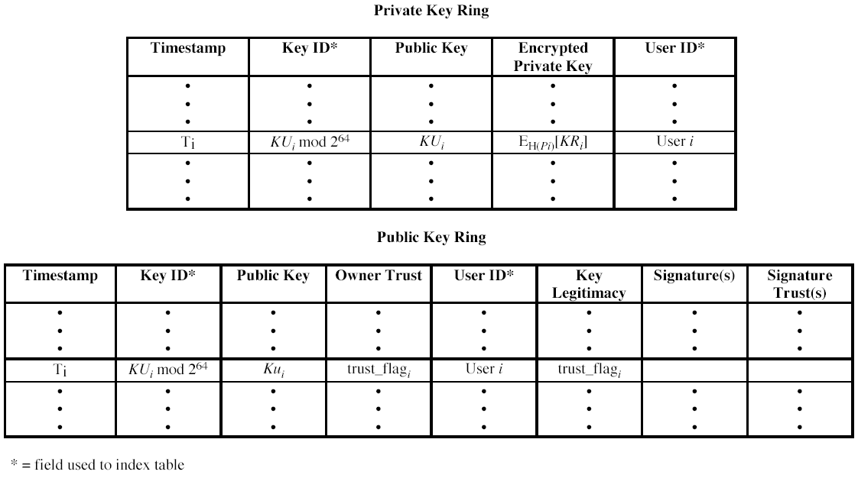
PGP Key Rings
(Stallings Fig 18.4)

Slide 20
PGP Key Management
Rather than relying on certificate authorities (CA), in PGP every user is own CA
Each user must build up a public-key ring containing the public keys of other users
Forms a “web of trust”
Trust keys signed by someone you “trust”
Can trust keys from a chain of signatures

Slide 21
S/MIME (Secure/Multipurpose Internet Mail Extensions)
Security enhancement to MIME email
Original Internet email (supported by SMTP) was text only
MIME provided support for varying content types and multi-part messages with encoding of binary data to textual form
S/MIME added security enhancements
Have S/MIME support in various modern mail agents: MS Outlook, Netscape, etc.

Slide 22
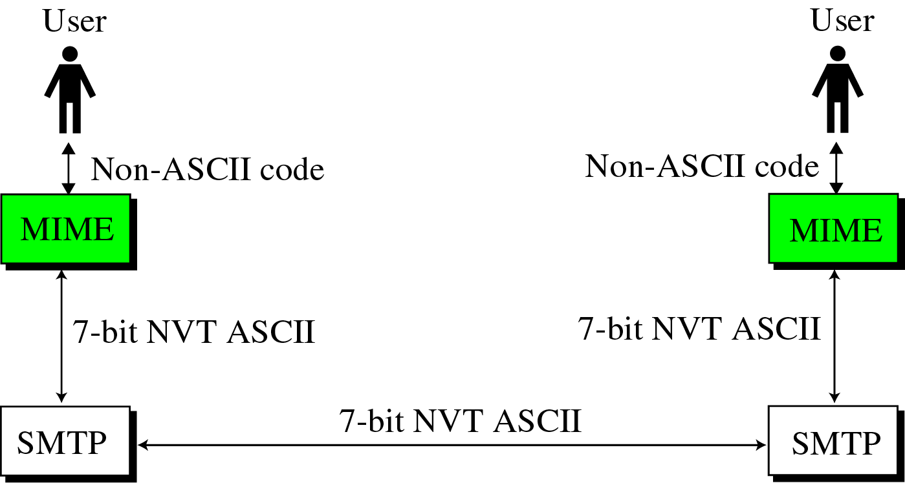
How MIME Works?

Slide 23
S/MIME Functions
Similar to PGP
Enveloped data
Encrypted content and associated keys
Signed data
Encoded message + signed digest
Clear-signed data
Cleartext message + encoded signed digest
Signed & enveloped data
Nesting of signed & encrypted entities

Slide 24
S/MIME Cryptographic Algorithms
Hash functions: SHA-1 (and MD5)
Digital signatures: DSS and RSA
Session key encryption: ElGamal & RSA
Message encryption: 3DES (RC2/40 and others)
Have a procedure to decide which algorithms to use

Slide 25
S/MIME Certificate Processing
S/MIME uses X.509 V3 certificates
X.509 is an international standard for telecommunications, which specifies, amongst other things, standard formats for public key certificates
Each client has a list of:
Trusted CA’s certificates, and
Own public/private key pairs & certificates
Certificates must be signed by trusted CA

Slide 26
Summary
Have considered:
Email security services
PGP
S/MIME

Slide 27
Next Lecture
IP Security…

Slide 28

Questions?

